Slide 1
XML MESSAGING ,SOAP, WSDL & UDDI
XML BASICS FOR WEB SERVICES

Slide 2
XML
Xml messaging
SOAP, UDDI and WSDL
Basics of XML
XML-RPC essentials
Real life web services
Standards of web service stack
Building & consuming xml web services in .NET
State Management

Slide 3
Xml messaging
Alternate to xml is XML-RPC,SOAP,HTTP GET/POST
WEB :
  Human-centric
  Application-centric (credit card verification, currency conversion, language translation,…)
    CGI, Servlets,..
  Automated (different presentation styles to access a common service) bug-free, gurantee, availability,..
XML-RPC, SOAP

Slide 4
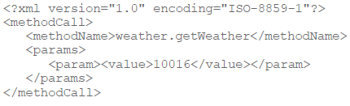
XML-RPC
Platform-independent
No Service description grammar
Simpler than SOAP & easier to adopt
Xml-rpc request

Slide 5
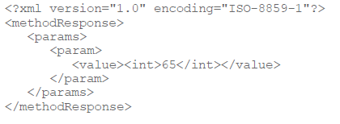
Xml-rpc response

Slide 6
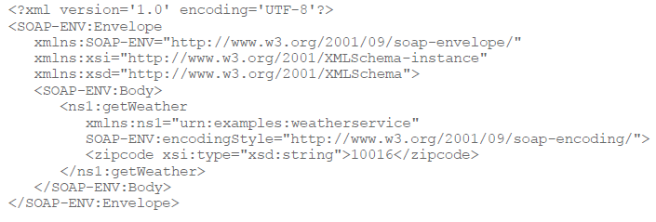
SOAP
Xml-based protocol
Complicated than XML-RPC request
Makes use of XML namespaces and schema
SOAP –REQUEST

Slide 7
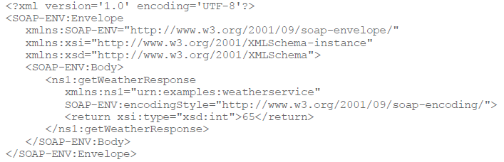
SOAP response

Slide 8
WSDL
Is an xml grammar for specifying a public interface for a web service
Include information on
  publically available functions
  Data type information for all xml messages
  Specific information about transport protocols
  Address information for locating the service

Slide 9
UDDI
White pages : general information
Yellow pages : general classification
Green pages : technical information

Slide 10
Basics of XML
What is XML?
HTML vs XML
XML prolog
Why XML?
XML Standards
Drawbacks of XML

Slide 11
Xml basics…
XML: text baed ML, fast becoming standard for data interchange on the web
HTML – specify how to display data
XML – specify how to identify data
<?xml version=“1.0” encoding=“utf-8” standalone=“yes”?>
Plain text, data identification, stylability, inline reusability, linkability, easily processed.
Standards:
  Basic : SAX,DOM,DTD,XSL,XSLT, Namespace
  Schema: DTD,XMLS, RELAX, SOX, TREX, SOOXML
  Link & presentation: Xlink, XMLBase, Xpointer, XHTML.
  Knowledge: RDF,RDFS,XTM,OWL,OWL-S.
  Standards based on XML – SMIL, MathML, SVG, DrawML, ICE, ebXML, CXML.

Slide 12
Drawbacks of XML
Takes lots of space to represent data to make human readable, platform neural, process-seperated, meta data enhanced, structured,..
3 to 20 times as large as binary / text file.
To store 1 GB database information in xml encoded format can take upto 20 GB
Structured Information process over Internet like relational DB, OODB is not easy…?

Slide 13
XML-RPC Essentials
XML-RPC
  to share resources over network
  direct access to the information
  not just read, mix and match to do the best
RPC : x = getvalue(j);
  program need to know which remote system to contact
  how to package and send params
  how to receive an answer
  how to unpackage and present the answer
  * extra overload with libraries on both sides
  * delays in crossing network
  * define interfaces as simple

Slide 14
XML-RPC
Server is made available at a particular URL
clinet (methods+params+target server)-package as XML, http post request->Server
Server <- req and pass to XML-RPC listener,get methods, params and pass to appropriate methods, return response, package....
Synchronous + stateless

